Slide 1
Amazon AWS EC2
23SP-033-CS | Abdul Mannan Ansari
23SP-008-CS | Talal Aslam
23SP-007-CS | Muhammad Sarmad Khan
23SP-031-CS | Shaheer Imran

Slide 2
Problem with Traditional Hosting
Traditional hosting requires physical hardware and manual setup.
Servers must be purchased, maintained, and kept.
Is slow and costly

Slide 3
What Cloud Computing Provides
Cloud computing provides on-demand virtual servers.
No physical hardware management.
Resources can be created and destroyed in minutes

Slide 4
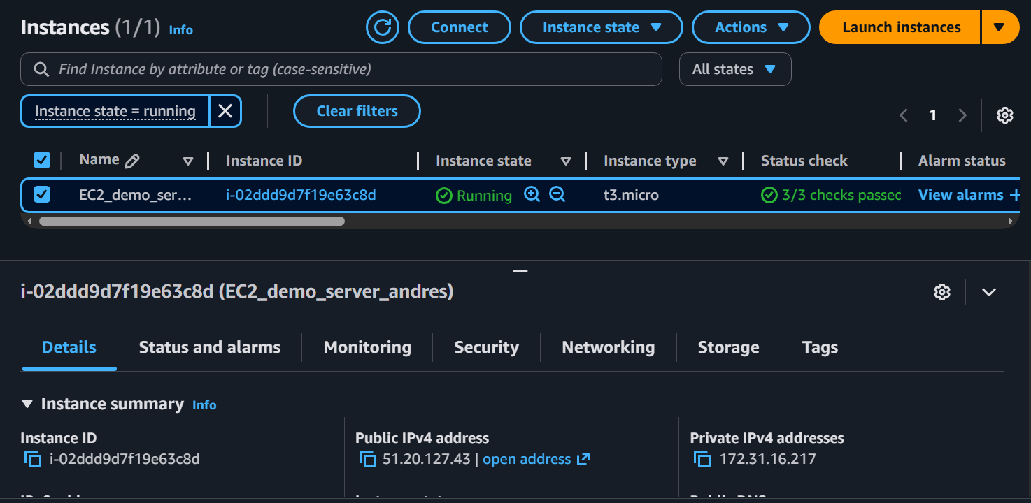
Cloud Infrastructure Used
EC2 instance running Ubuntu Linux
Public IP for global access
Security rules controlling inbound traffic (HTTP, SSH)

Slide 5
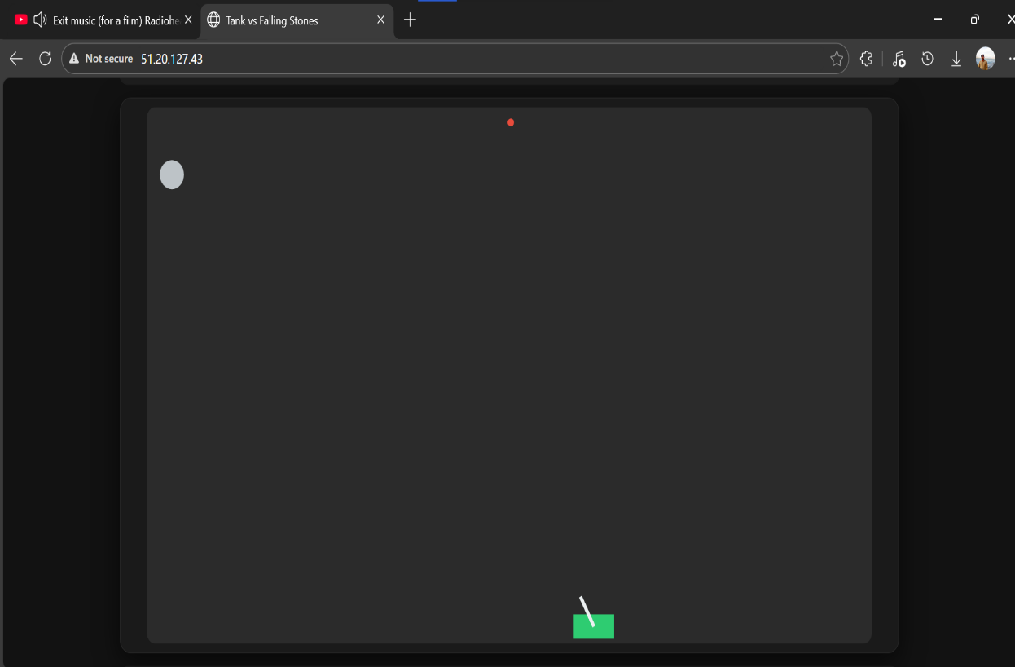
Deployed Application
Web server installed on a remote machine.
Static and interactive content hosted.
Application accessible through a browser.

Slide 6
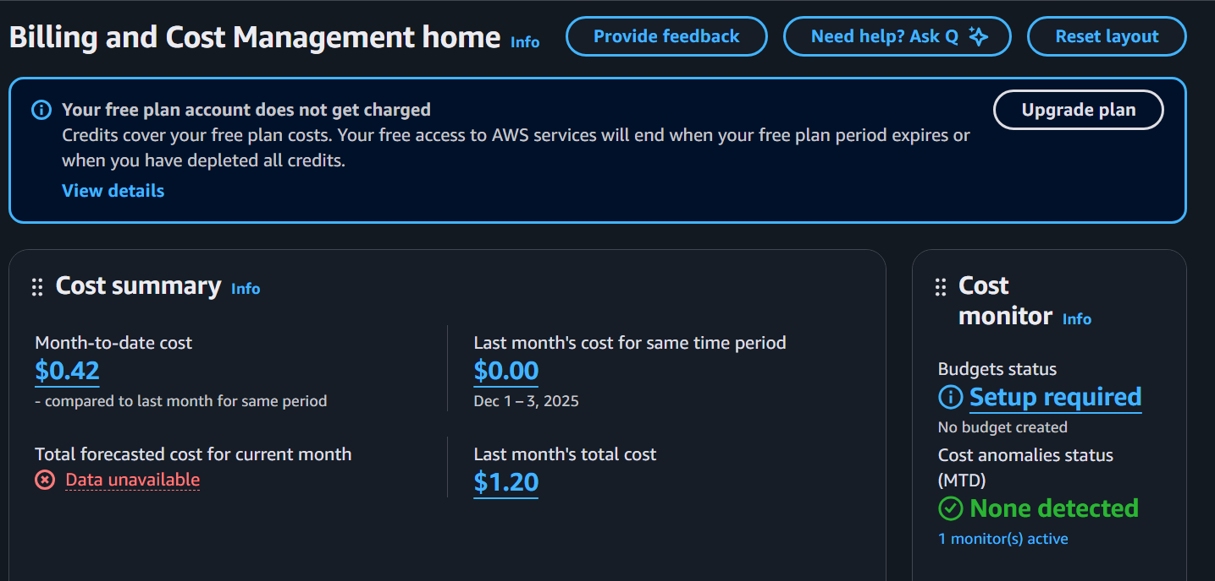
Cost and Time Efficiency
Entire setup completed in under an hour.
No upfront cost using Free Tier.
Instance can be stopped or deleted anytime.

Slide 7
Advantages of Cloud
Infrastructure details are abstracted.
Focus remains on application logic.
Scaling and networking handled by the platform.

Slide 8
Advantages of Cloud Cont.
Cloud turns servers into disposable resources.
Faster development and deployment.
Lower cost and lower risk for experimentation.

Slide 9
Disadvantages of Cloud
Dependence on internet connectivity.
Ongoing cost if resources are left running.
Requires proper security configuration to avoid exposure

